Slide 1
Fontawesome Icons for Websites
Rana Zain Idrees

Slide 2
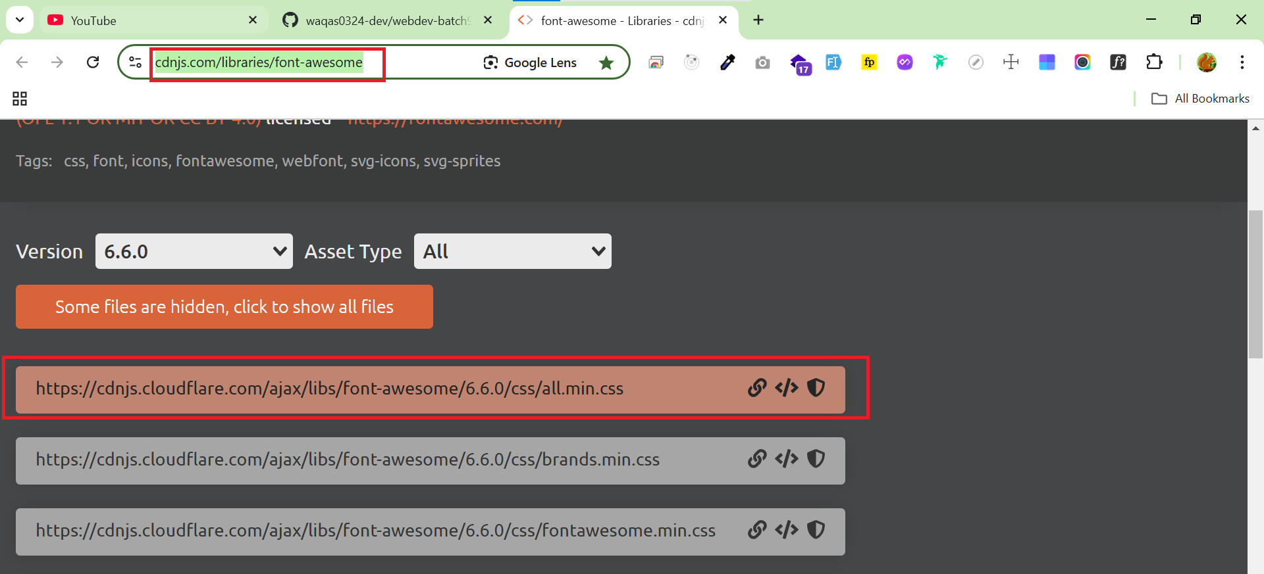
JS Deliver CDN
https://cdnjs.com/libraries/font-awesome

Slide 3
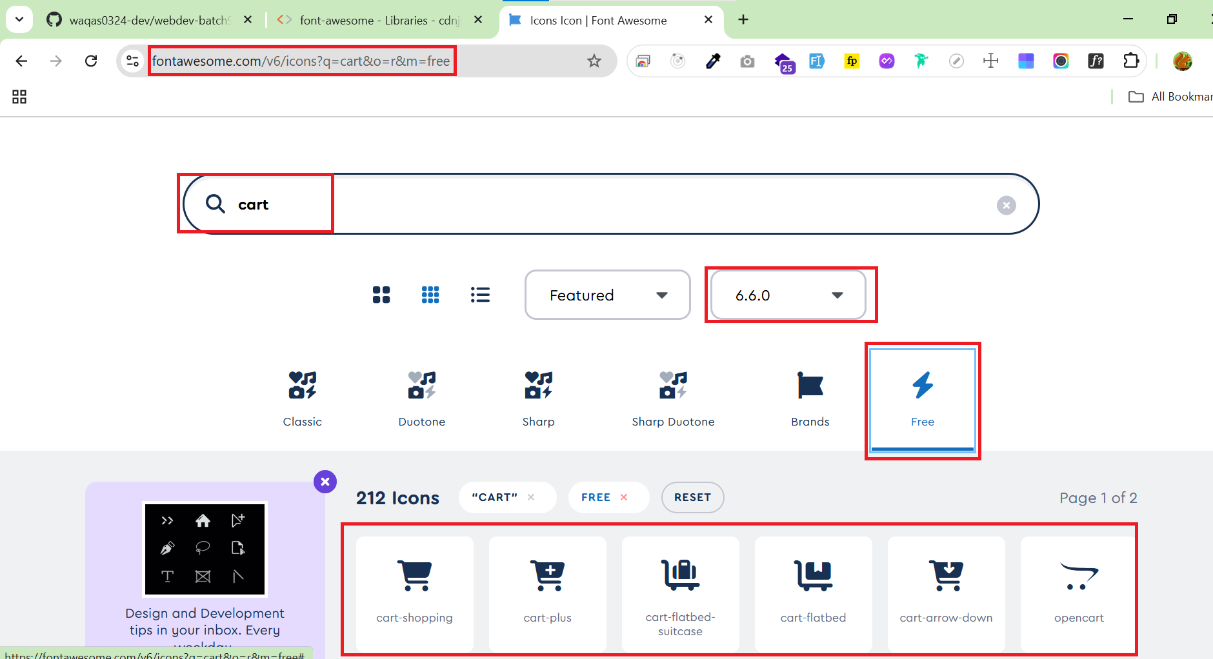
Font Awesome Icons
https://fontawesome.com/v6/icons

